Slide 1

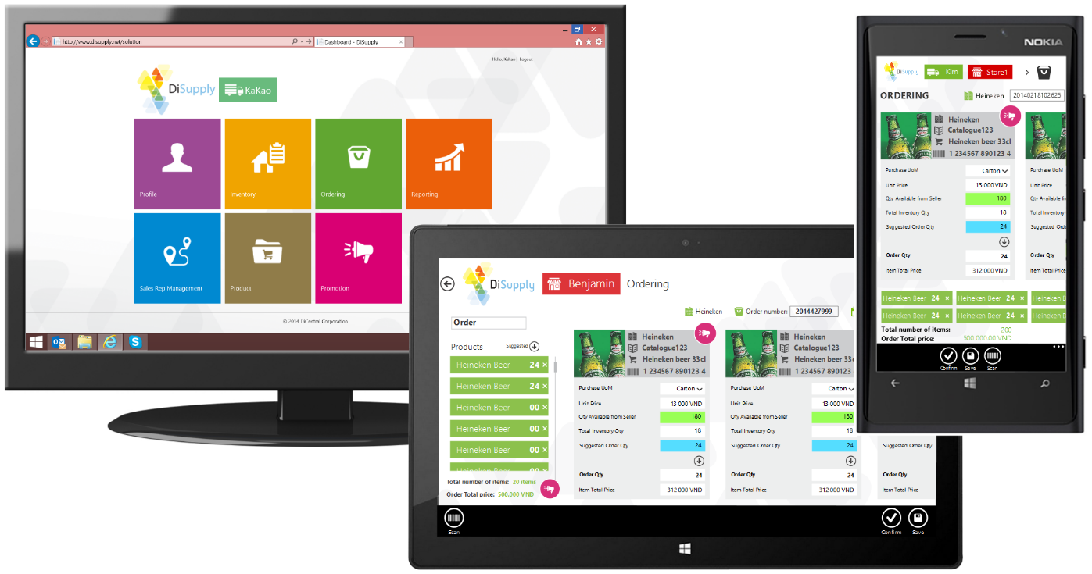


Training document: Overview

Slide 2
Content:
Solution Overview
Platform Overview
Main Features

Slide 3




Market Needs
Supply Chain Community
The common business relationships

Slide 4
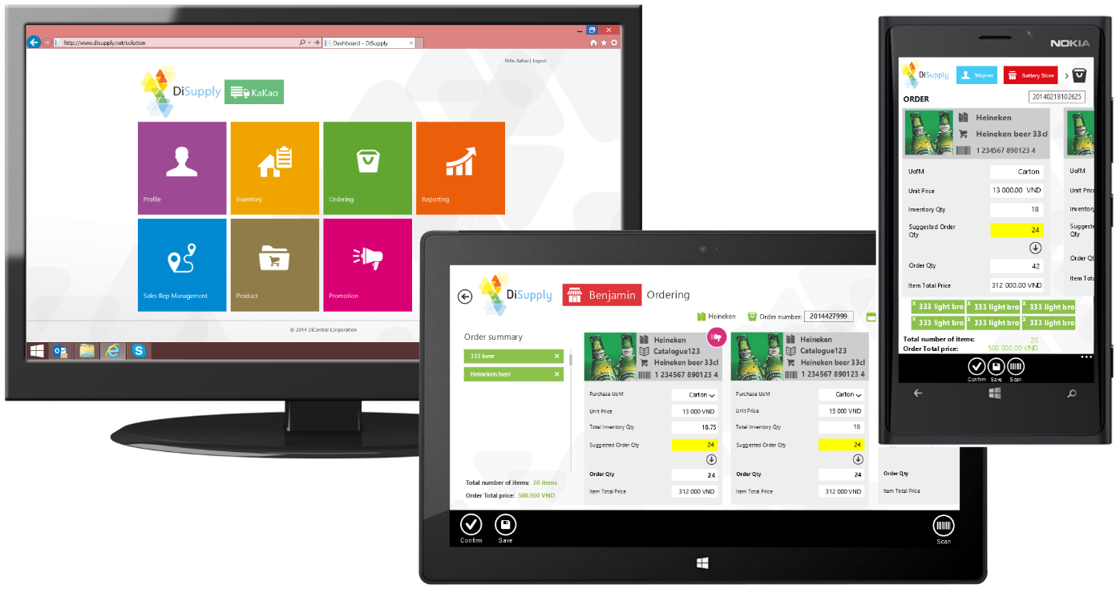
The response …as we see it
The Real-Time B2B Network
DiSupply enables your entire Supply Chain community to connect, manage and collaborate with your network through DiCentral’s B2B cloud platform.

Slide 5
Solution Overview
WMS
Functionalities for all members of the community, for real collaboration
Supporting mobility for real-time access, from everywhere
Providing true integration throughout multiple systems for real optimization
ERP

Slide 6

Platform Overview
B2B cloud and Many - to-Many (multi tenant) enabling the full Supply Chain Community to Connect, Transact and Exchange
ERP
Integration
WMS
Integration

Slide 7
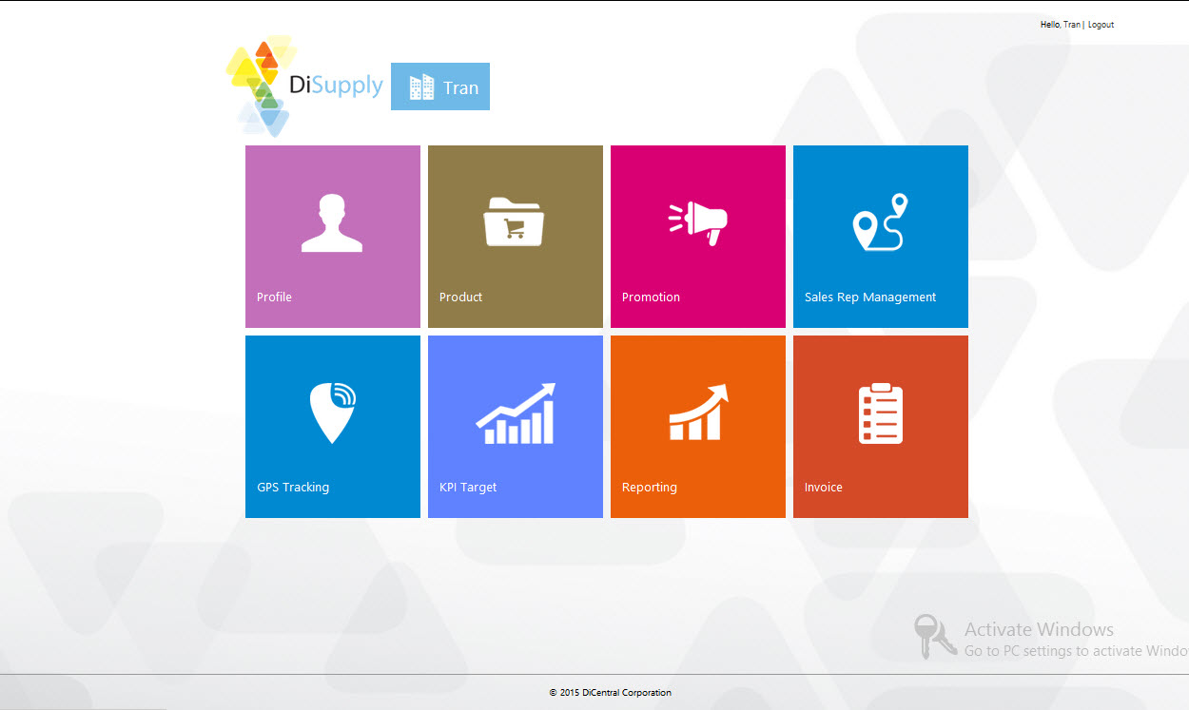
Main Features
Vendor site

Slide 8
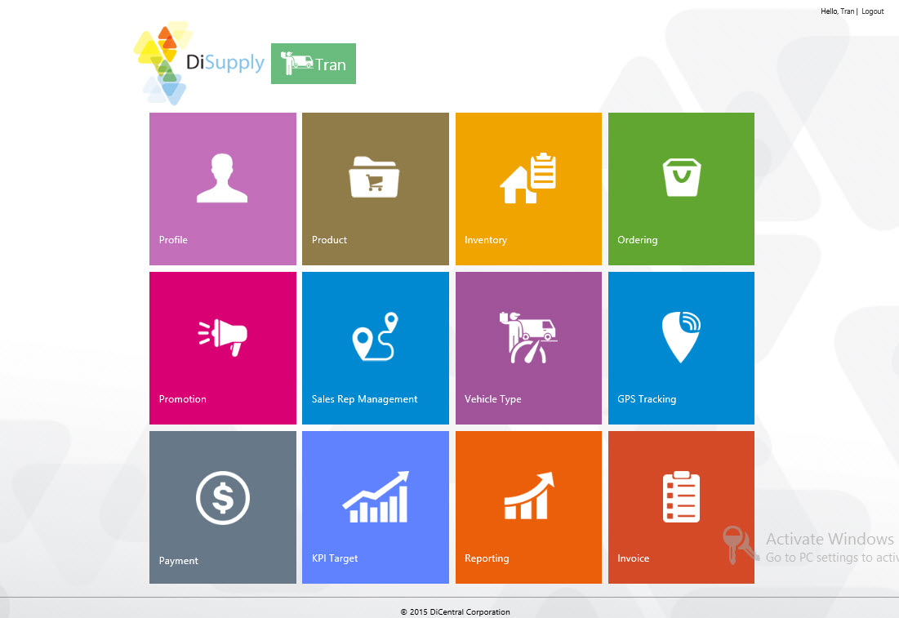
Main Features
Distributor site

Slide 9
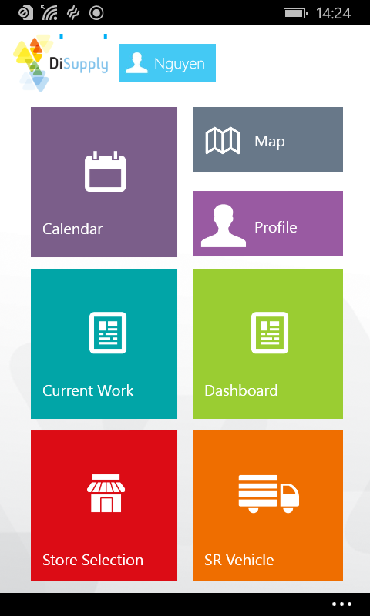
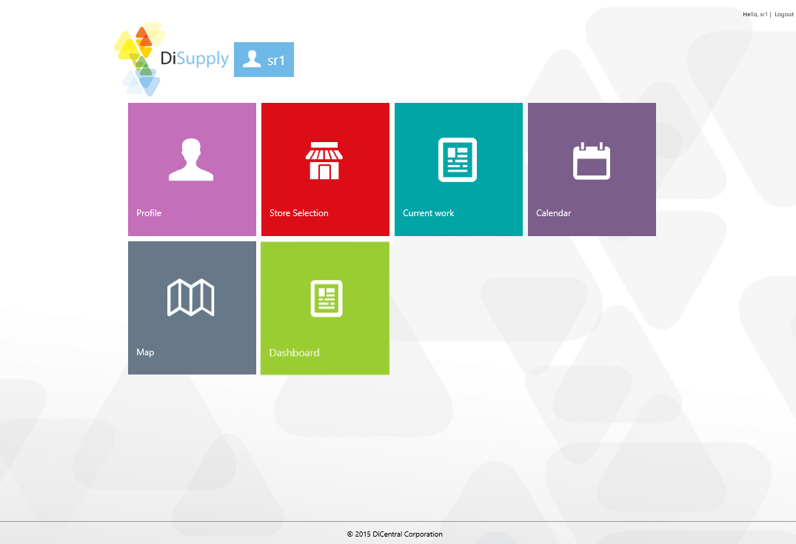
Main Features
Sales Rep. site

Slide 10
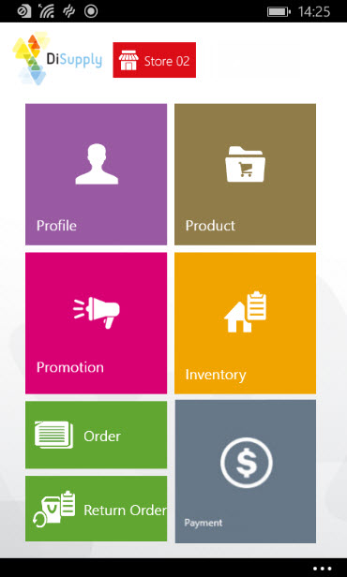
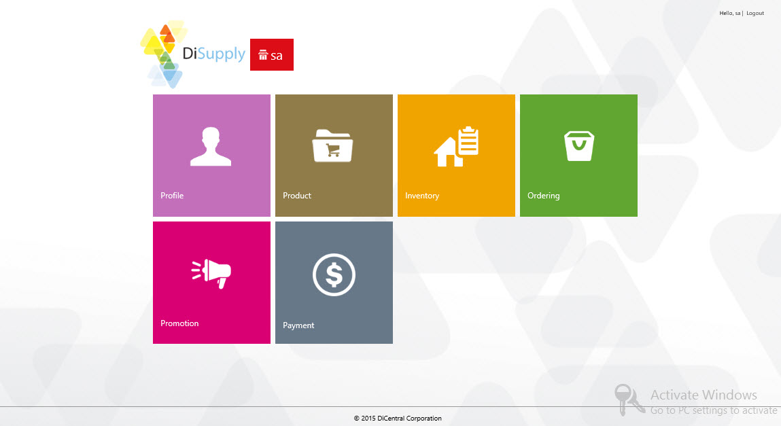
Main Features
Store site

Slide 11
Thank you!
The link to practice with DiSupply: http://disupply.dicentral.com.vn:8080/DiSupply/account/login

